Slide 1
QUERYING OF WALMART SALES DATABASE USING PostgreSQL

Slide 2
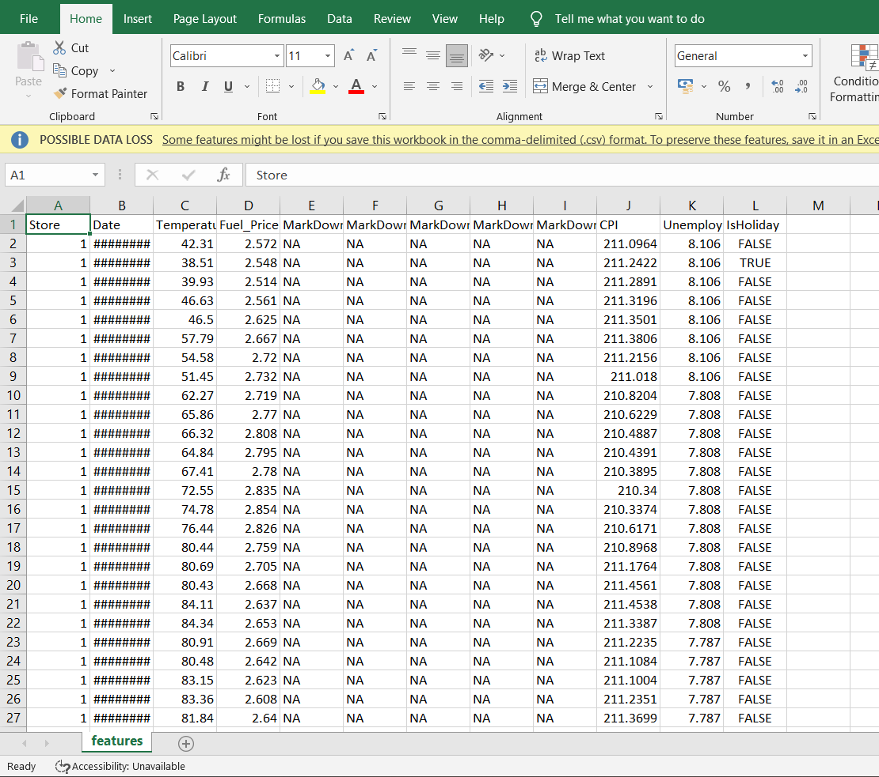
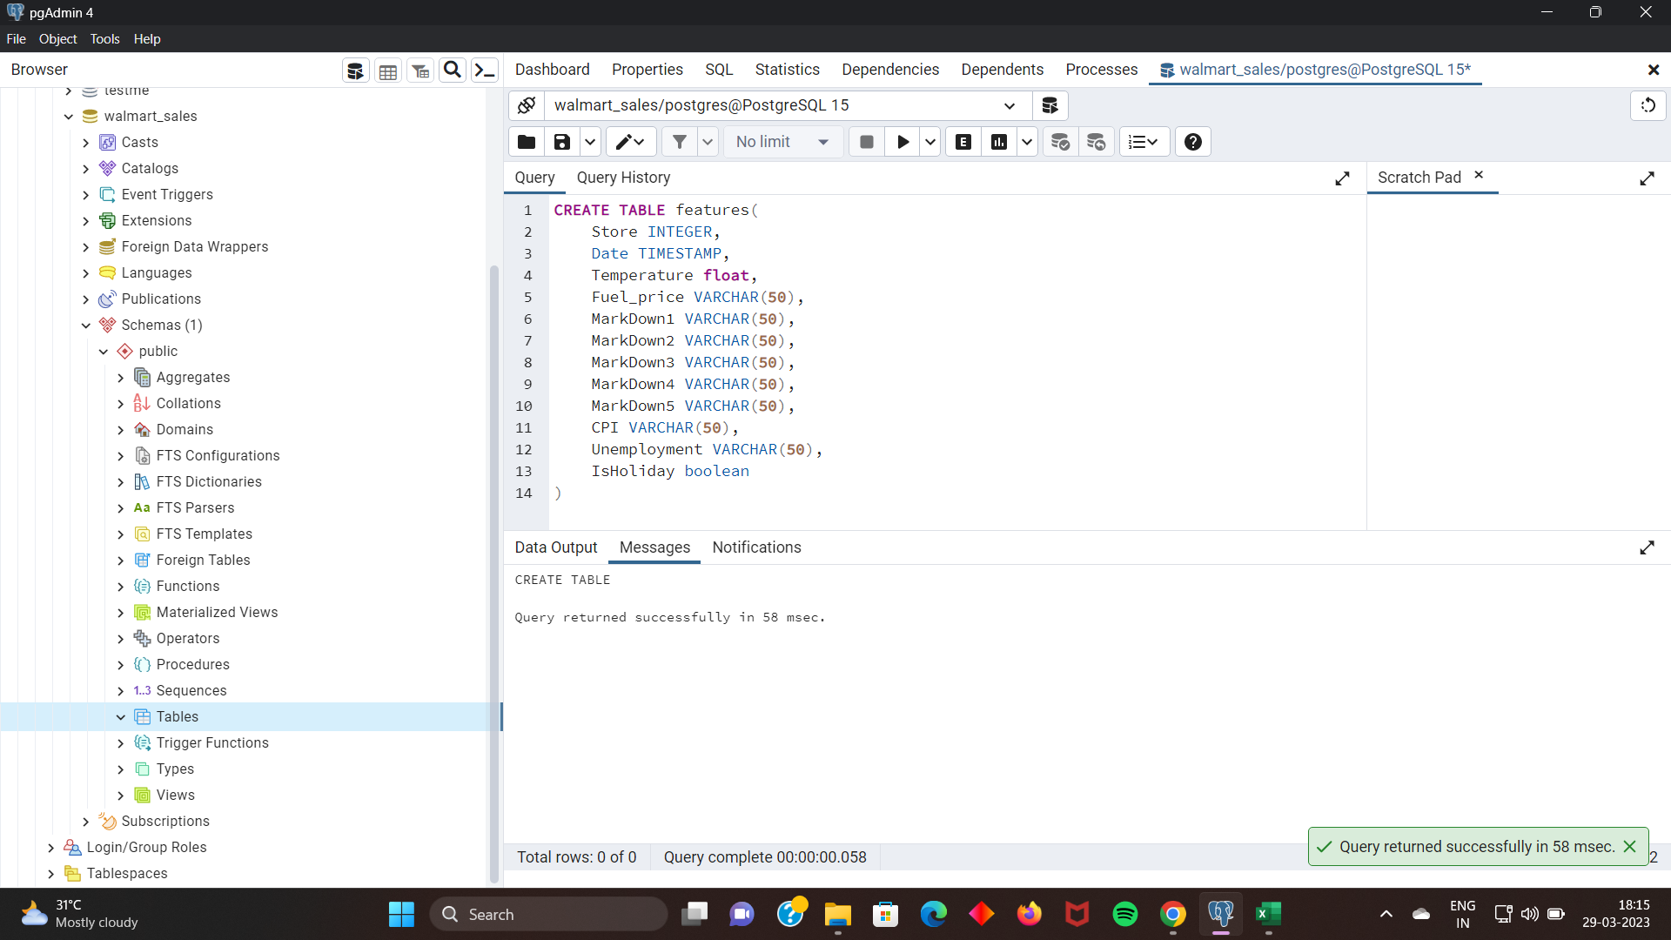
Importing .CSV data of walmart_sales into postgreSQL

Slide 3
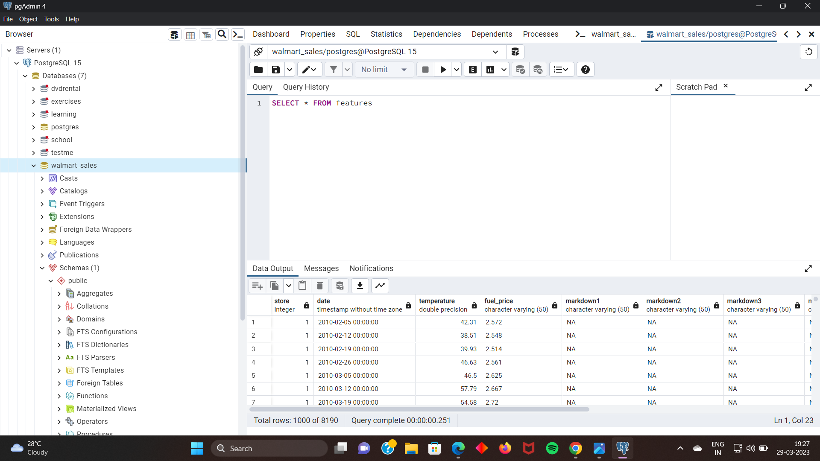
Importing .CSV data of walmart_sales into postgreSQL

Slide 4
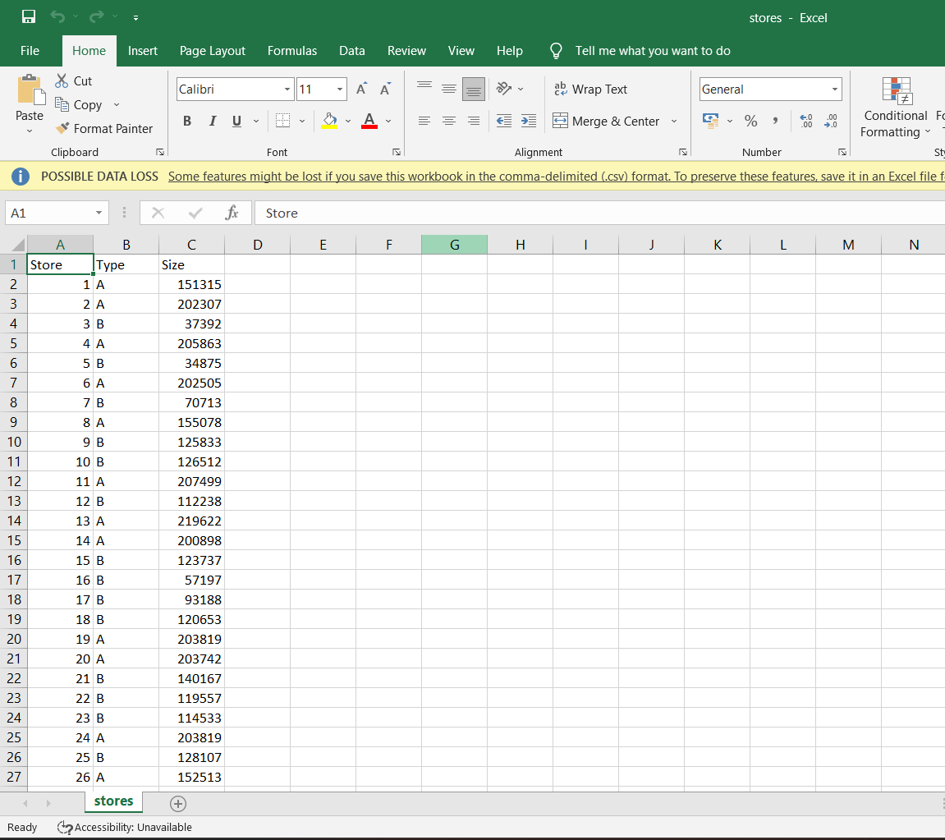
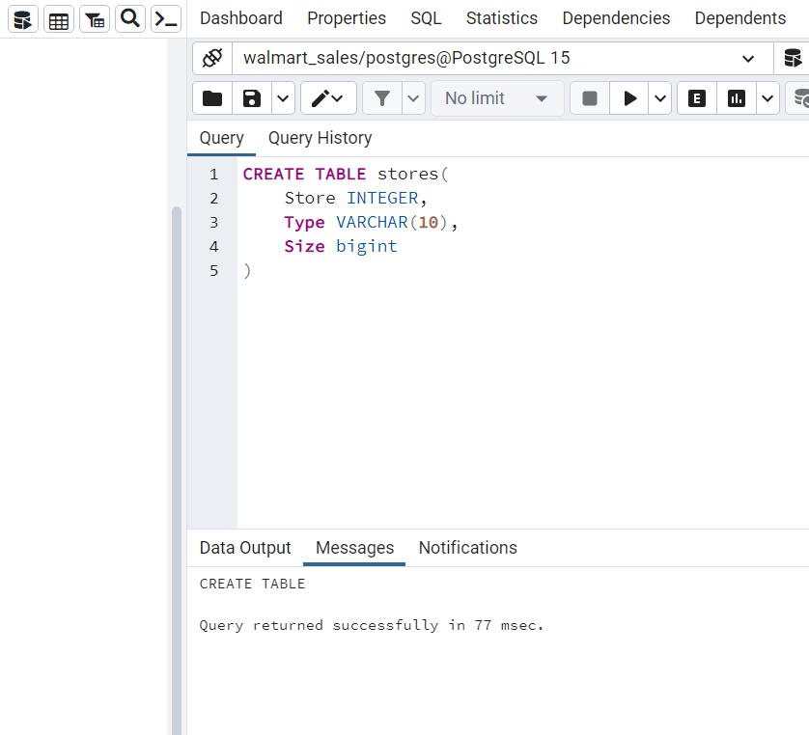
Importing .CSV data of walmart_sales into postgreSQL

Slide 5
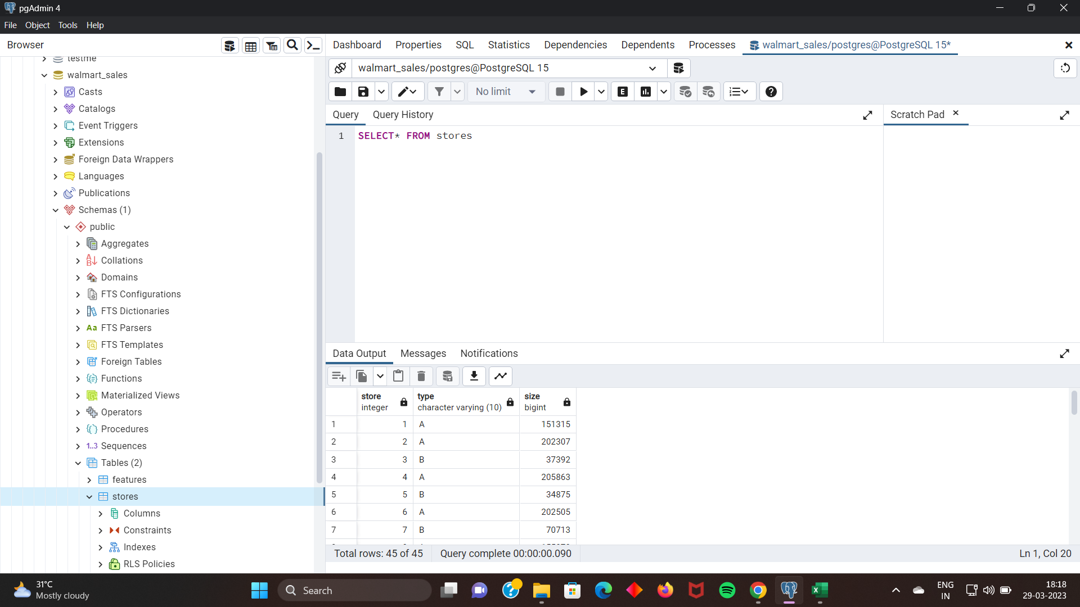
Importing .CSV data of walmart_sales into postgreSQL

Slide 6
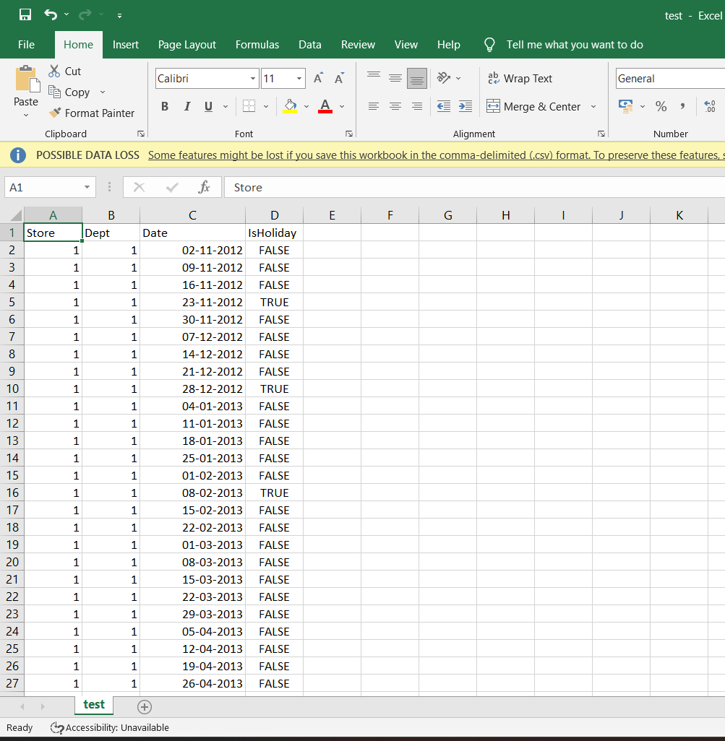
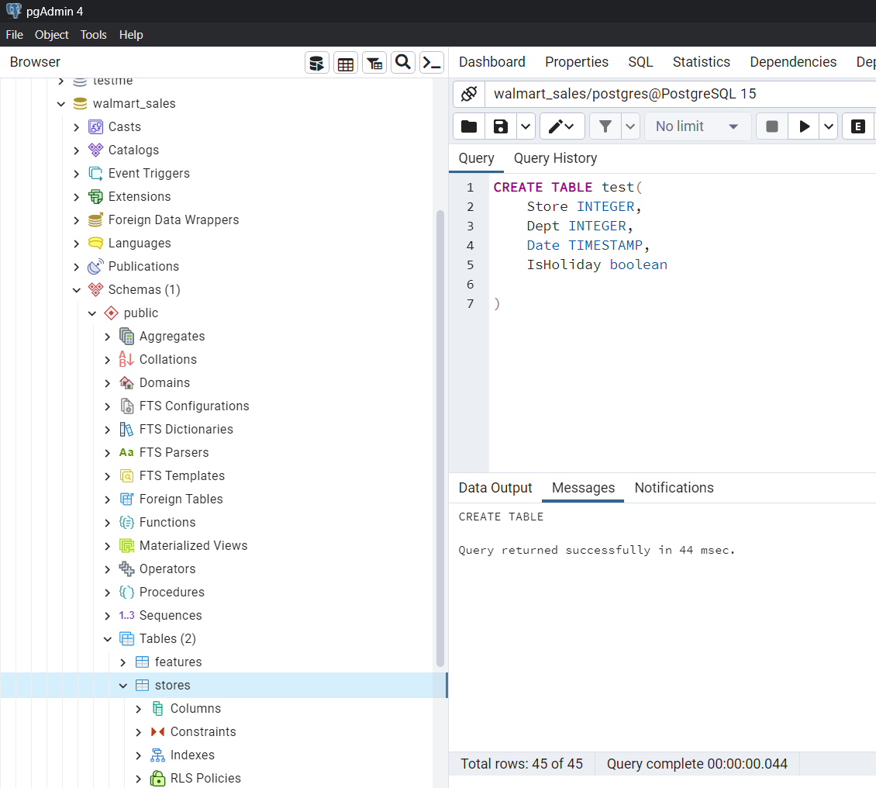
Importing .CSV data of walmart_sales into postgreSQL

Slide 7
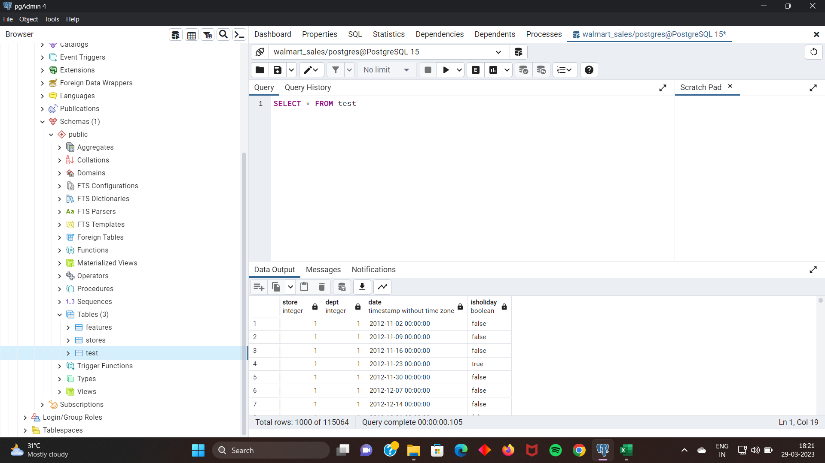
Importing .CSV data of walmart_sales into postgreSQL

Slide 8
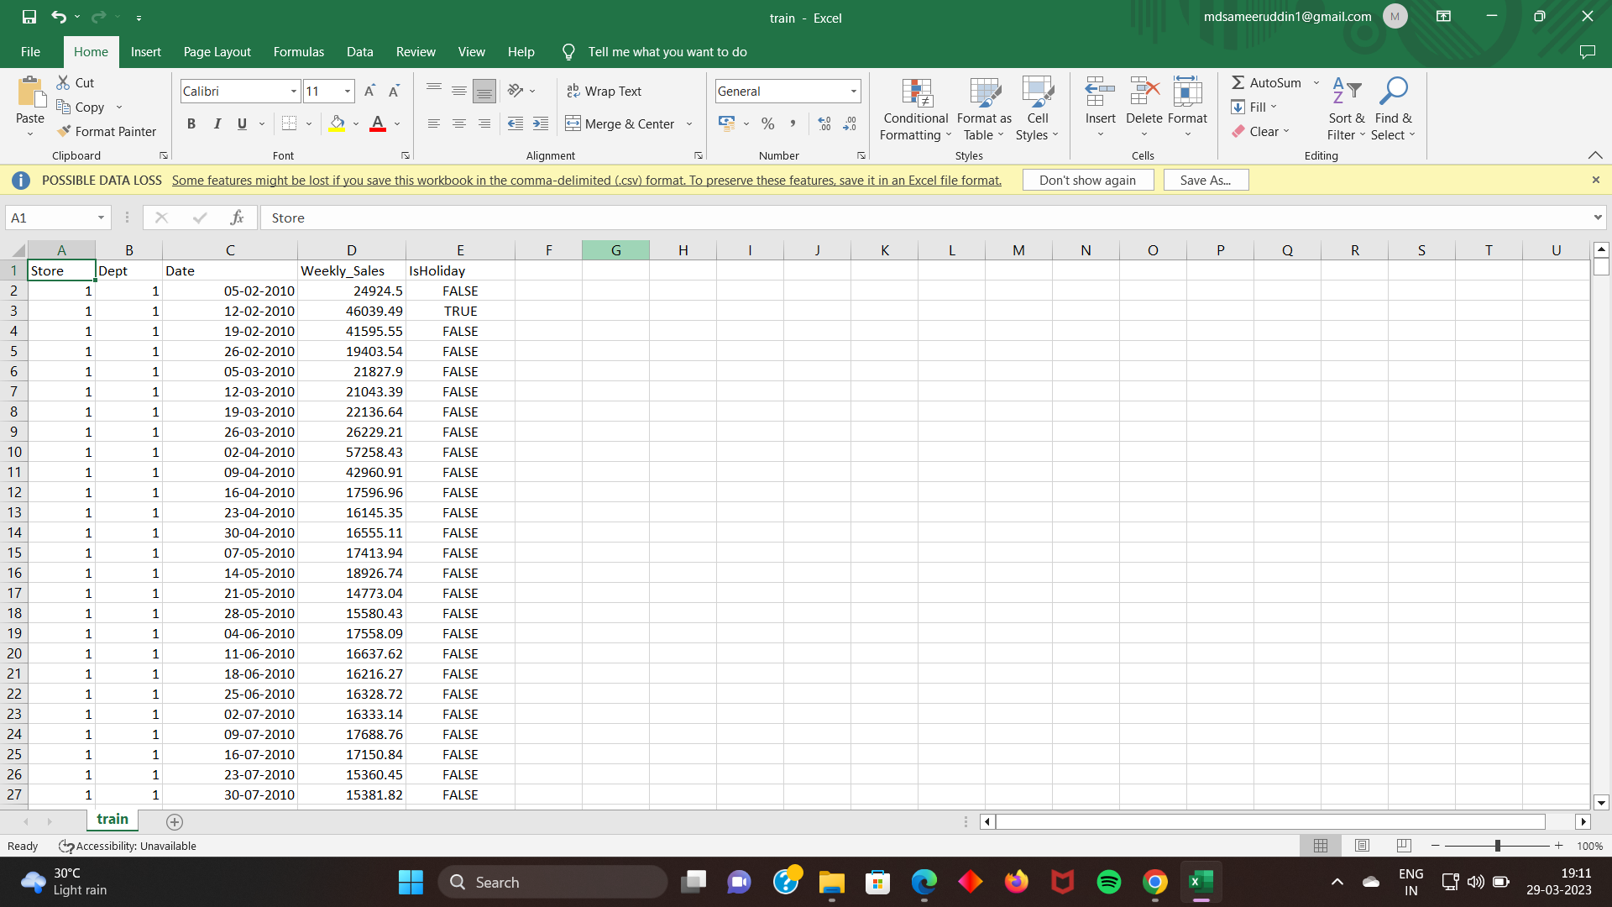
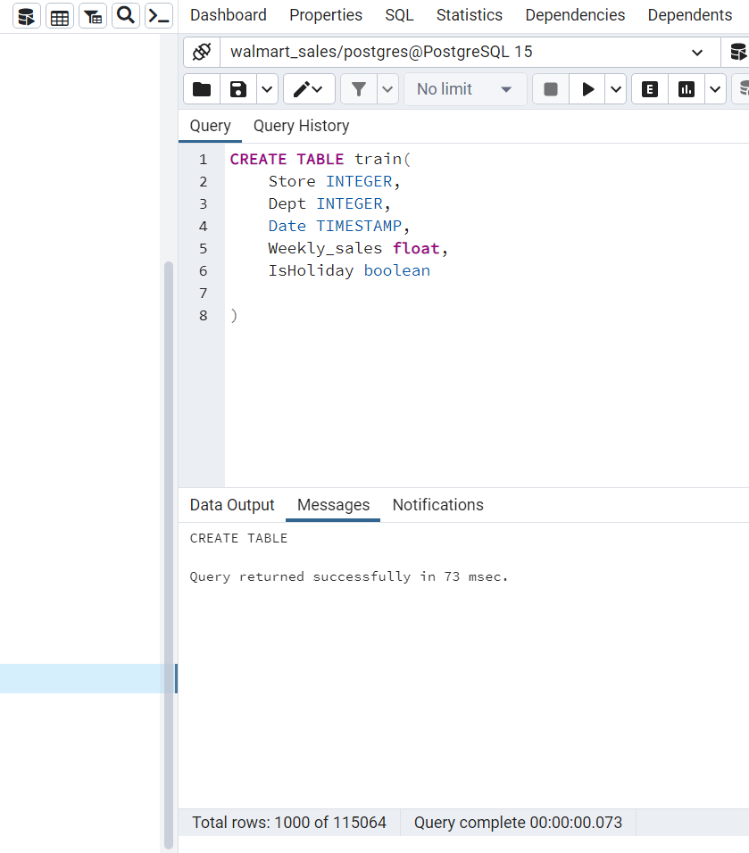
Importing .CSV data of walmart_sales into postgreSQL

Slide 9
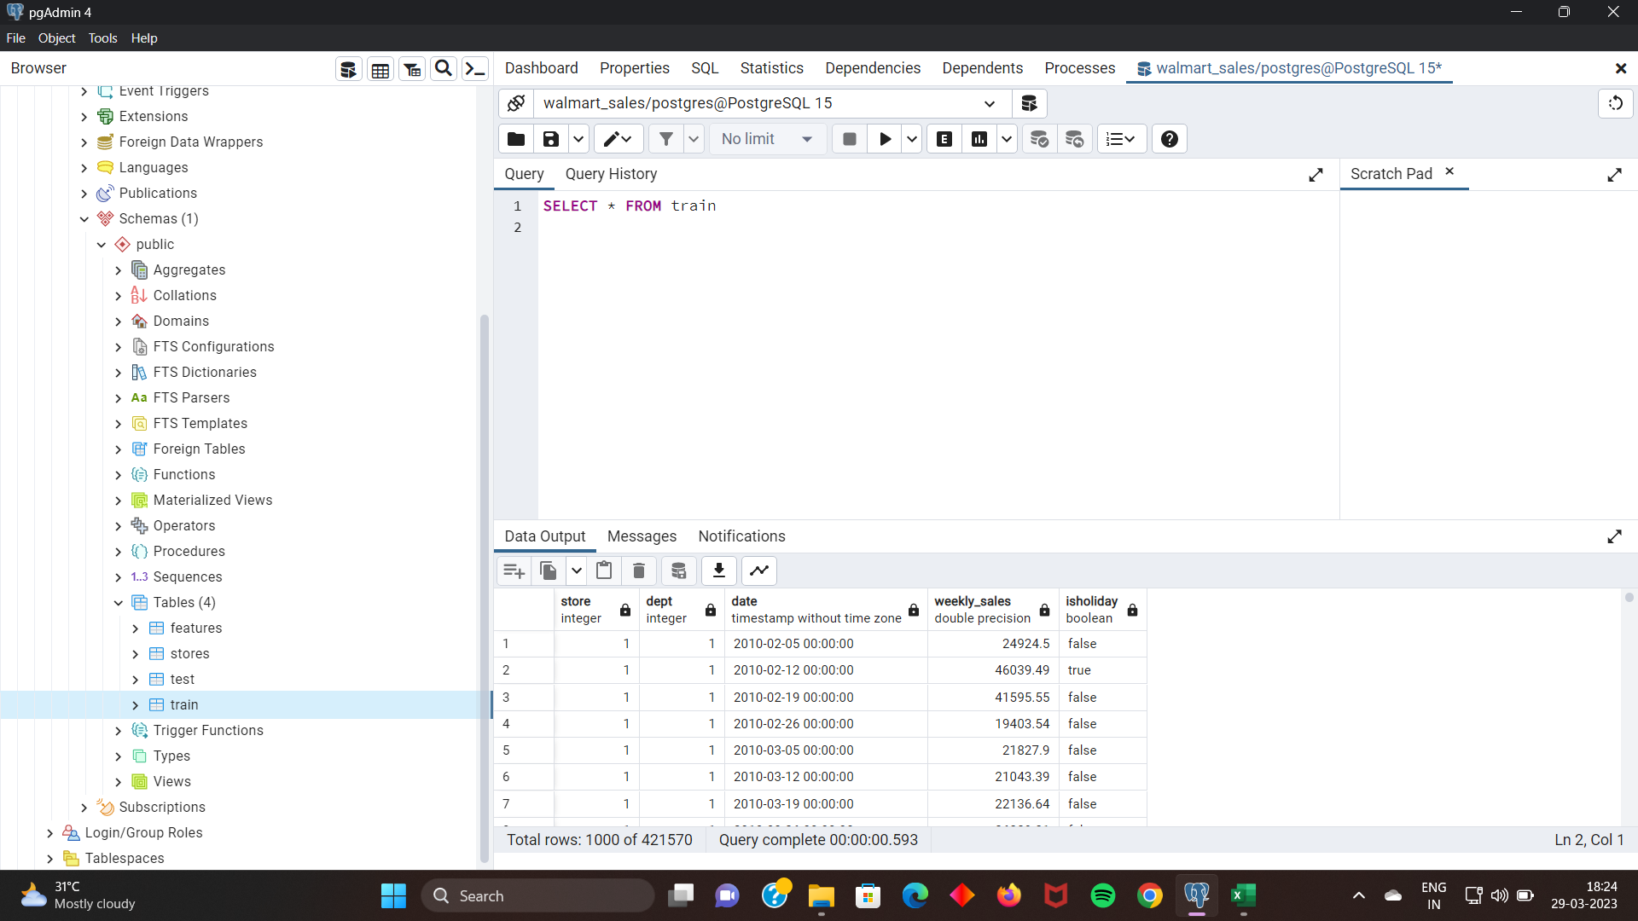
Importing .CSV data of walmart_sales into postgreSQL

Slide 10
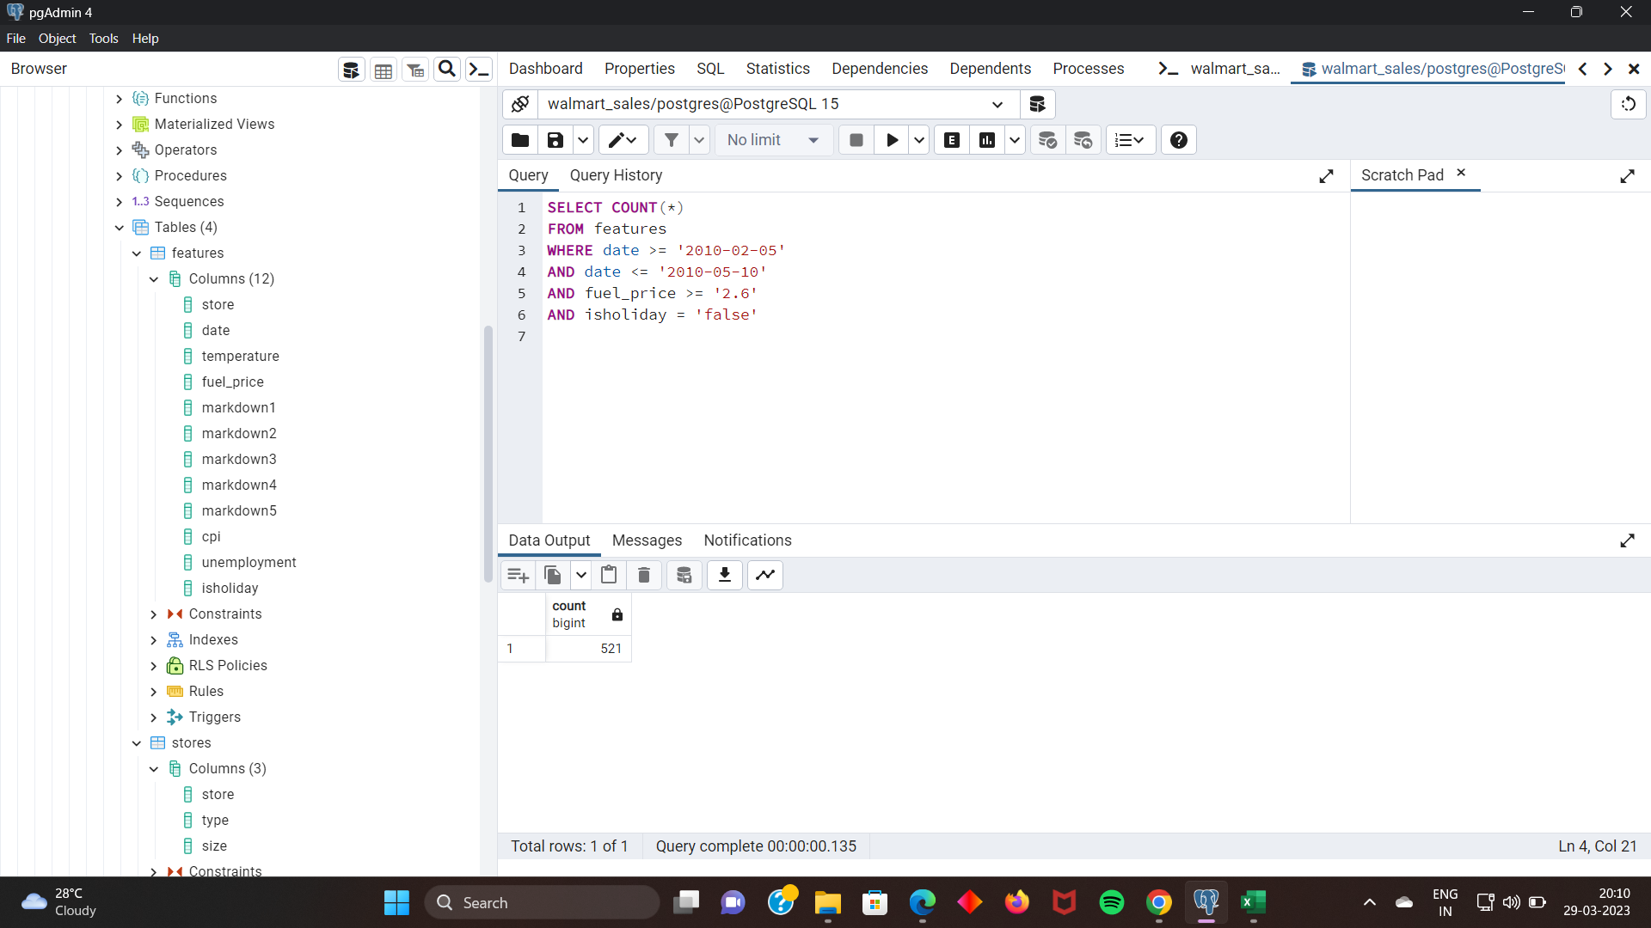
The total number of data entries between "2010-02-05" and "2010-03-10" that were made on a business day for the shop and had a fuel price greater than 2.6.

Slide 11
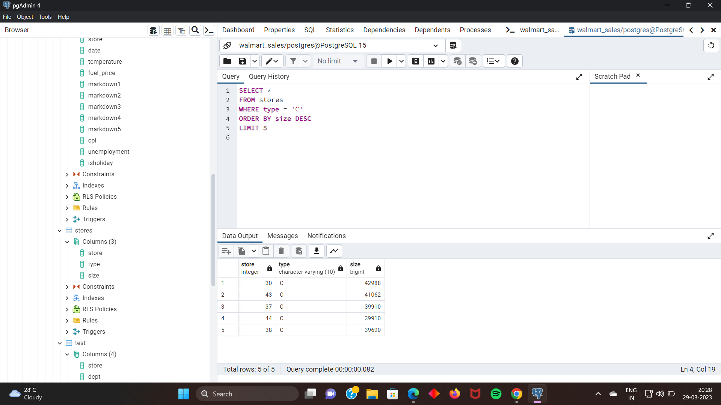
List of the top 5 largest stores according to their size and of ‘C’ type arranging in decreasing order.

Slide 12
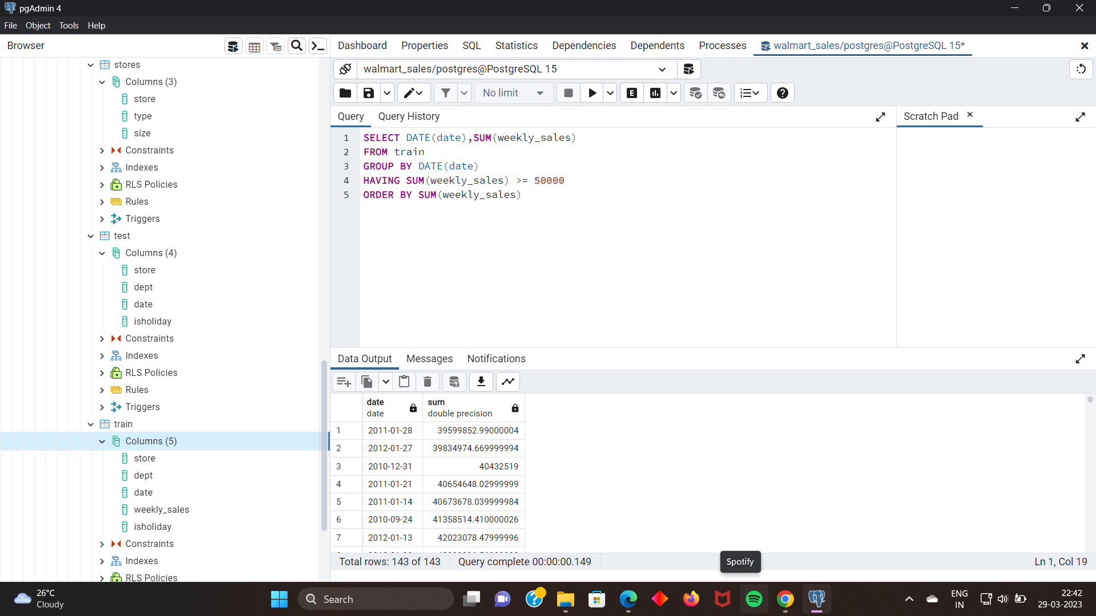
List of total sum of weekly sales of all stores date wise ranking from highest to lowest

Slide 13
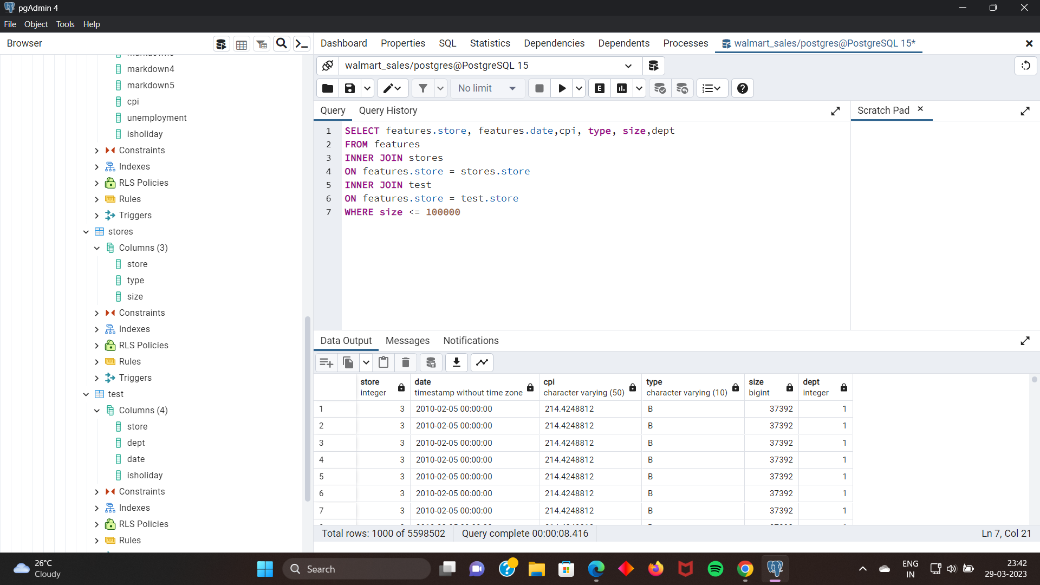
Creating a list consisting of store, date, Consumer Price Index(CPI), type of store, department & size of the store where the size of store is less than 100000.

Slide 14
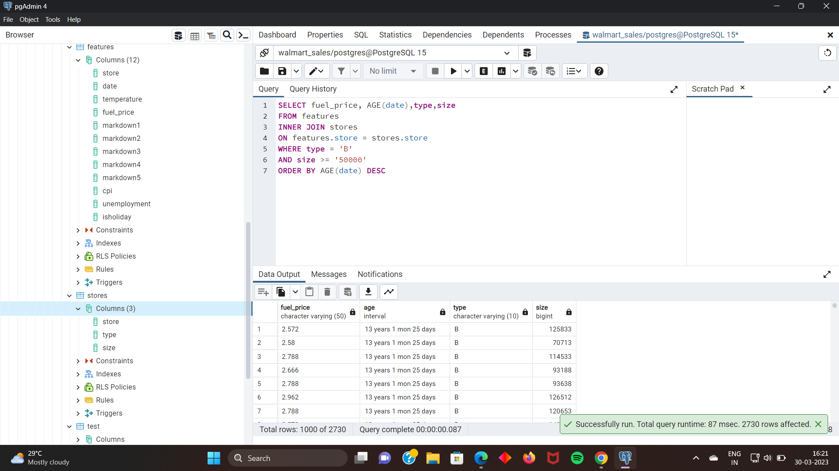
Creating a list consisting of fuel price of each day for type B stores of size greater than 50000 arranged from oldest to newest

Slide 15
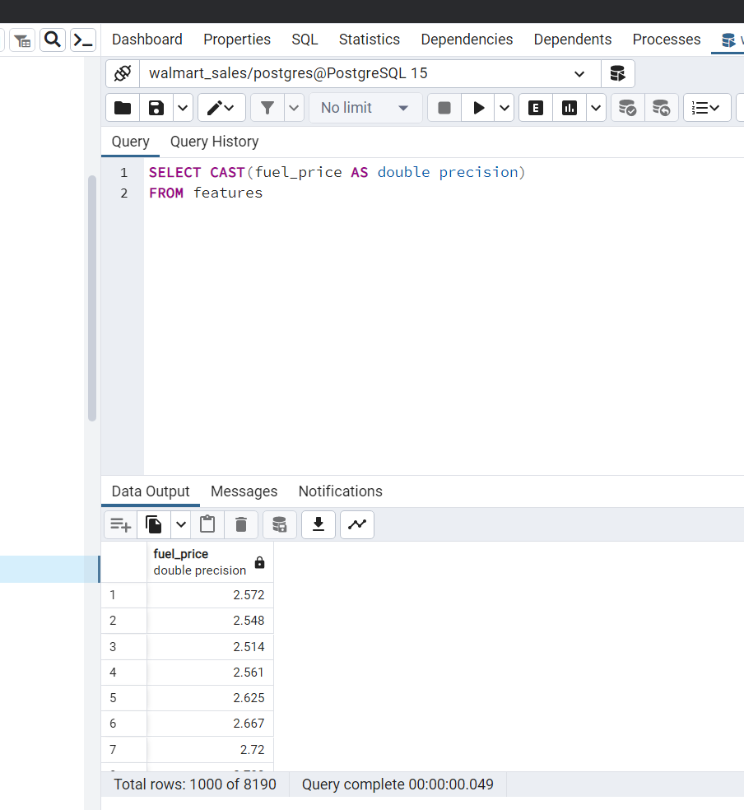
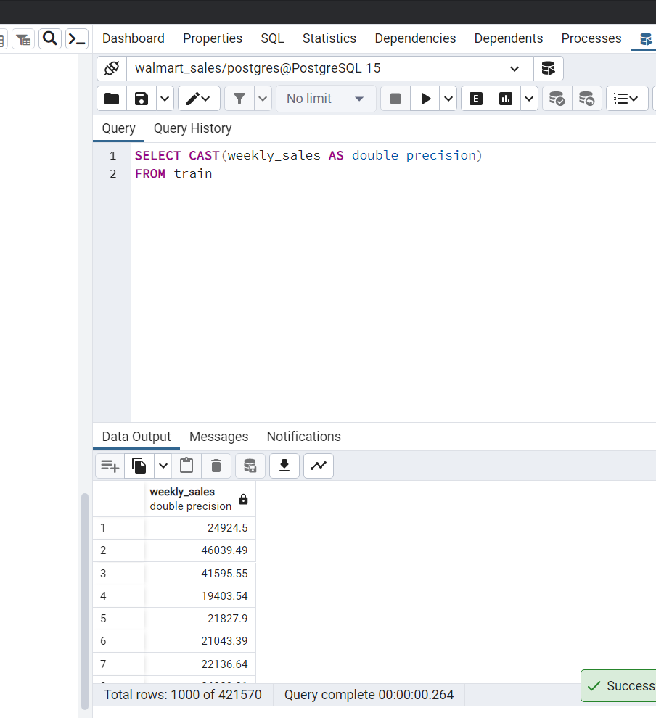
Converting fuel_price and weekly_sales data types into double precision to make them useful for mathematical calculations from VARCHAR datatype .

Slide 16
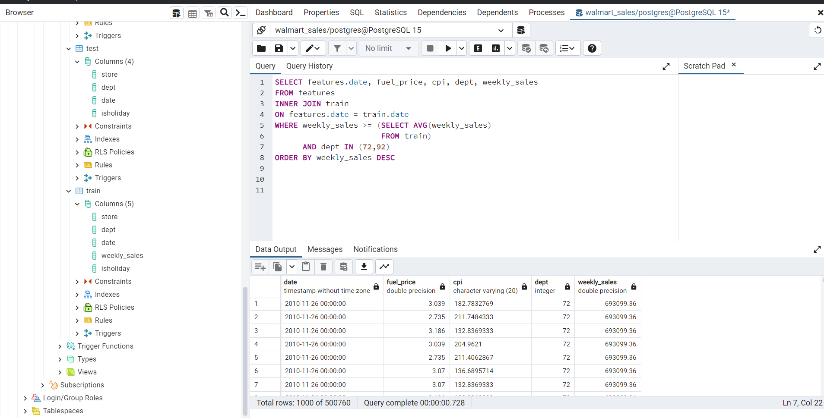
Creating a list which contains the dates when the weekly sales are greater than the overall average weekly sales for 72 & 92 departments arranged in the decreasing order of weekly sales.

Slide 17
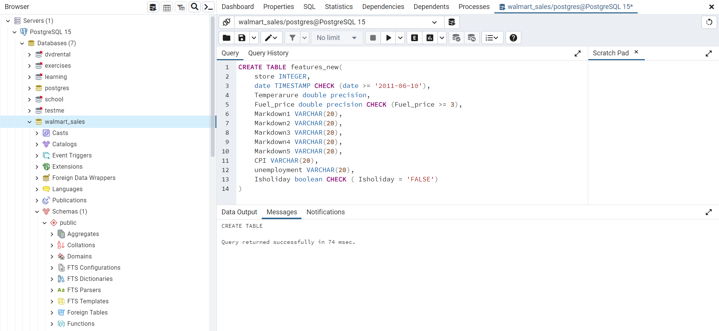
Creating a table ‘features_new’ to import .CSV data into the table which consists of data only after ‘ 2011-06-10’ & when fuel price > 3 & it is a working day for the stores.

Slide 18
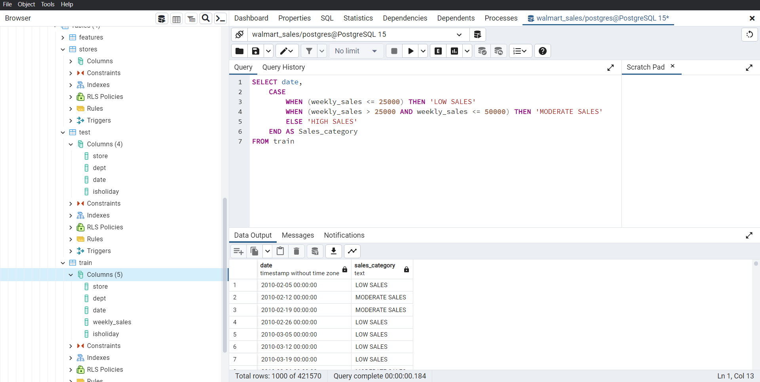
Creating a list which shows sales category as HIGH SALES (<25000) / MODERATE SALES (25000-50000) / LOW SALES(>50000) for each date .

Slide 19
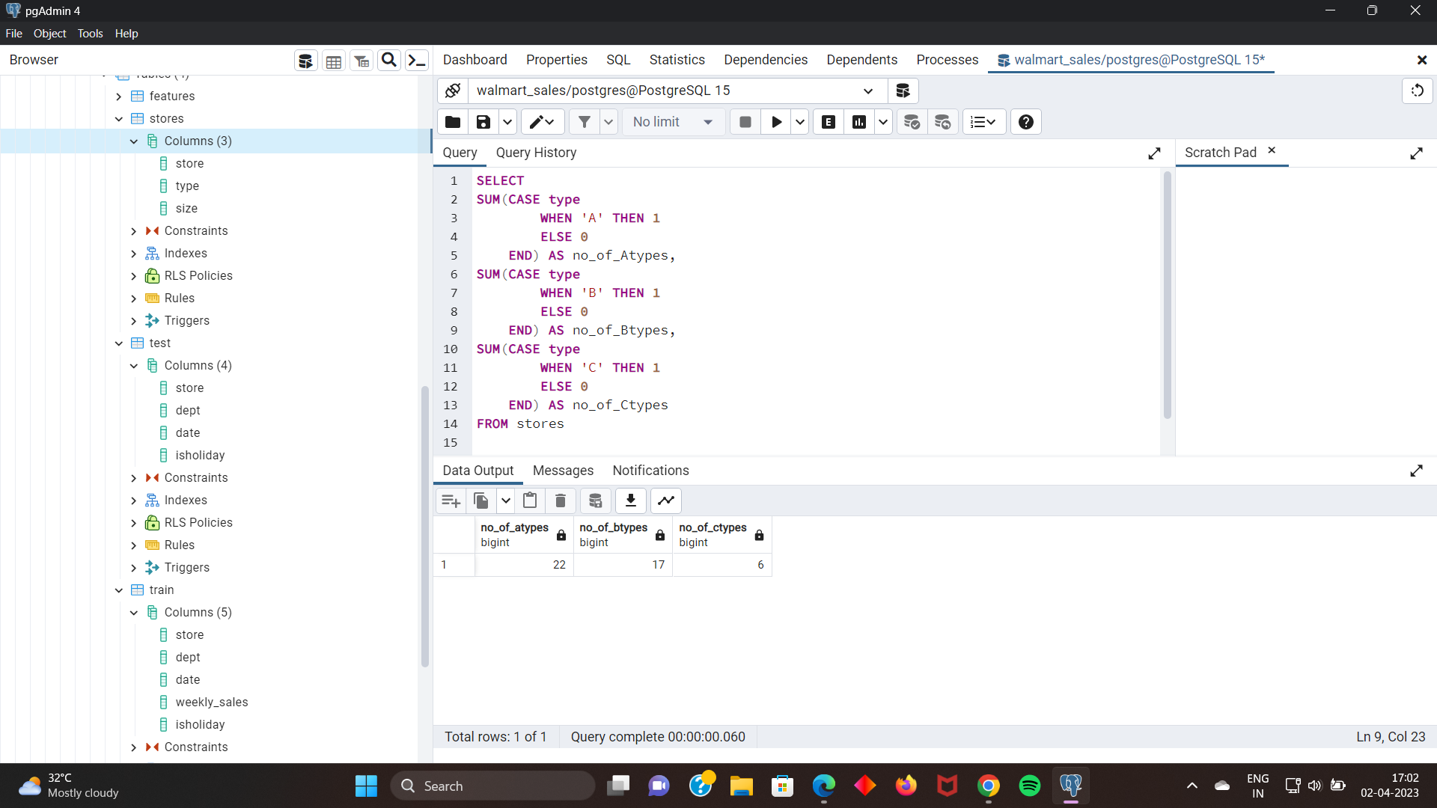
Creating a list which shows total number of each type of stores A, B & C

Slide 20
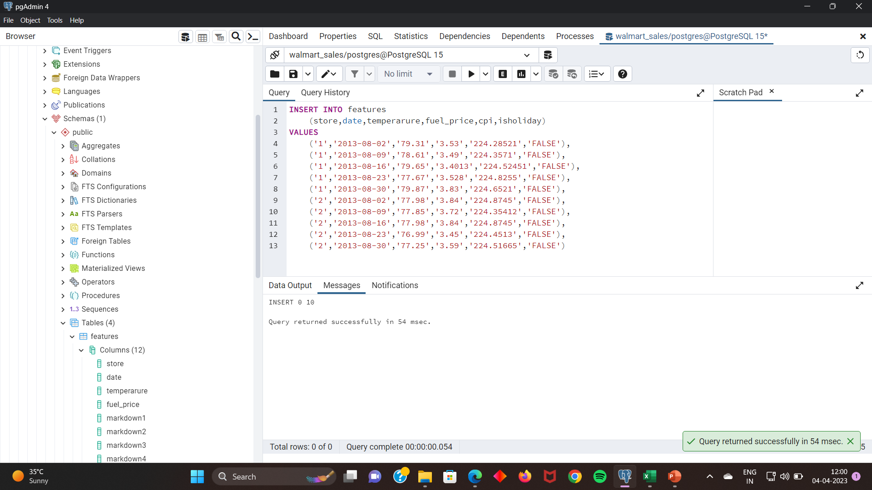
Inserting the available data of August month of 2013 into features table of store 1 and store2 .

Slide 21
THANK YOU
MOHAMMED SAMEERUDDIN

